Slide 1
Drug Use, Drug Control and Human Rights:
Issues Raised at UNGASS and Satellite Meetings: How should ISAM respond?
Norman Wetterau MD, DFASAM, FAAFP
Associate Professor FM, University of Rochester
Representative to UNGASS from ISAM

Slide 2
Conflict of Interest
Work for nonprofit family medicine group, state outpatient chemical dependency program and small amount for teaching.
No money taken from any pharmaceutical company or other entity
No conflict of interest

Slide 3
Learning Objectives:
Review UN drug treaties and recent report from UNGASS 2016
Look at groups who view the right to use drugs as a protected human right
Consider other human rights like the right to justice, right to live in a drug free community and right to treatment for addiction
Consider ISAM's response to the debate

Slide 4
UN Conventions and Treaties 1961, 1972, 1988
Allow opioids and cocaine for medical reasons: controlled growth, physician prescription
Cultivation, sale and transportation for non-medical reasons would be considered criminal activity
Does not demand that personal use is criminal
Main thrust is against production, sale and especially organized crime

Slide 5
Conventions Endorse Treatment: Article 36 Penal Provisions
"Notwithstanding the preceding subparagraph, when abusers of drugs have committed such offenses, the Parties may provide, either as an alternative to conviction or punishment or in addition to conviction or punishment, that such abusers shall undergo measures of treatment, education, after-care, rehabilitation and social reintegration in conformity with paragraph 1 of article 38. Article 38. Measures against the abuse of drugs…”
Single Convention on Narcotic Drugs - United Nations Office on Drugs and Crime

Slide 6
Reasons for UNGASS
Increase in drug trade: request of Central American Countries
Increase in drug use
Desire of some to modify the previous agreements, including legalization
Concern for Human Rights: UN Human Rights Council Report Dec. 2015

Slide 7
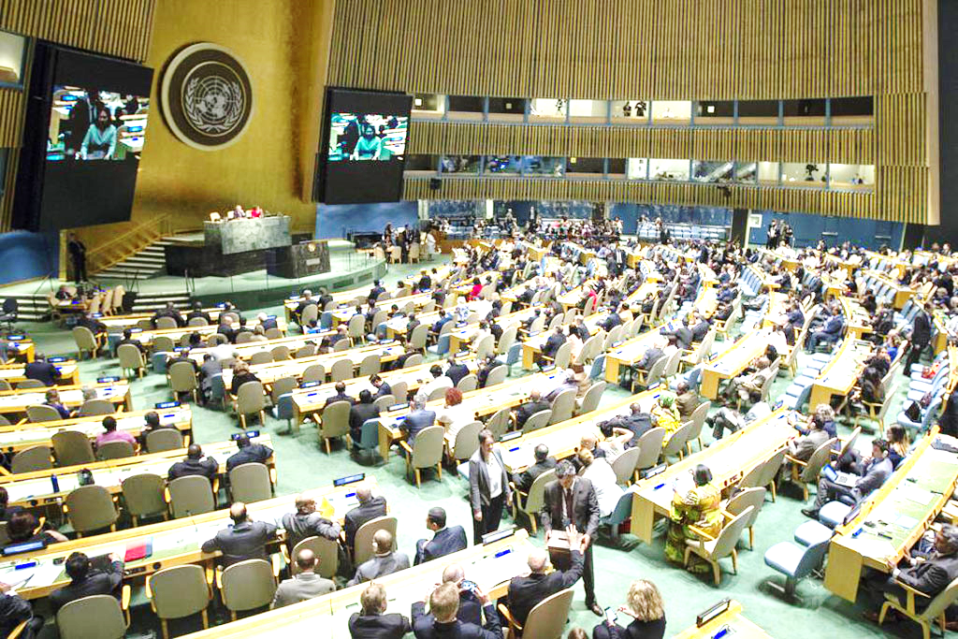
Special Session of the United Nations General Assembly on the World Drug Problem April 19 – 21, 2016

Slide 8
Official UN Report
Full 22 page report: google UN special session for copy of report
Public health model: prevention, harm reduction and treatment
Sections on sales and organized crime
Making opioids available for end of life care and acute pain
The basic conventions were not altered, but there may be greater emphasis on prevention, and treatment
Place of human rights in the document

Slide 9
Official Report and Human Rights
2 sections with multiple recommendations:
Proportionate and effective policies and responses, as well as legal guarantees and safeguards pertaining to criminal justice proceedings and the justice sector:
fair laws, fair sentencing, access to treatment, humane
prisons, alternatives to prison
Operational recommendations on cross-cutting issues: drugs and human rights, youth, children, women and communities
BUT AFTER THE MEETING SOME OF THE NGO GROUPS WERE VERY CRITICAL OF THE UN DOCOMENT AND PLANNED TO TAKE THEIR CASE TO THE UN HUMAN RIGHTS COMMISSION RATHER THEN TO THE WHO OR COMMISSION ON NARCOTICS AND DRUGS

Slide 10
Vienna NGO Committee on Drugs and The New York NGO Committee on Drugs
Wide variety of opinions Africa: very concerned about the youth and about other countries selling drugs and taking away their nation’s limited funds.
North America: a group that favored legalization. Much talk about harm reduction and little about treatment. ASAM and ISAM spoke out for treatment and recovery in addition to harm reduction.
Full reports: www.cstfondrugs.org or Google “Civil society task force” scroll to bottom to site map
Notes:
This 100 page report summarizes the various viewpoints.

Slide 11
Harm reduction: two views
ASAMS definition
A treatment and prevention approach that encompasses individual and public health needs, aiming to decrease the health and socio-economic costs and consequences of addiction-related problems, especially medical complications and transmission of infectious diseases, without necessarily requiring abstinence.
Abstinence-based treatment approaches are themselves a part of comprehensive Harm Reduction strategies. A range of recovery activities may be included in every Harm Reduction strategy.
“Harm reduction is often made an unnecessary controversial issue as if there was a contradiction between prevention and treatment on one hand and reducing the adverse health and social consequences of drug use on the other. This is a false dichotomy. They are complementary.”
(Antonio Maria Costa, UNODC, 2007) et
Some groups only mention harm reduction, not treatment or recovery.

Slide 12
NGO Meeting Before UNGASS 2016
Many participants were talking about harm reduction, but not about treatment.
There are millions of people in recovery due to medical treatment, 12 step groups, religious and other recovery groups
The best harm reduction is stopping drug use and entering into recovery

Slide 13
2016 Approved Document
“We reaffirm our determination to tackle the world drug problems and to actively promote a society free of drug abuse in order to help to ensure that all people can live in health dignity and peace with security and prosperity and reaffirm our determination to address public health , safety and social problems resulting from drug abuse…*”
UN has other similar goals: the goal to rid the world of POLIO, HIV, TB, POVERTY
* Outcome Document Of The 2016 United Nations General Assembly Special Session On The World Drug Problem

Slide 14
Human Rights
Right to use drugs (Drug laws are a violation of human rights) OR
Just and fair laws, equal justice, rehabilitative justice: applies to drugs but also other issues
Right to live in a drug free community
Right to treatment and recovery

Slide 15
Nonprofit, registered in England, but with chapter in many countries Budget 700,000 dollars
Extensive Website.
The document lists 10 rights and 24 demands.
Notes:
In 2015 they published a consensus statement: (I agree with many) Not sure if any other group shares all their views but their emphasis on drugs as a human rights issue rather than a medical problem is shared by many.

Slide 16
Human Rights of People who Use Drugs
RIGHT 1: People who use drugs are entitled to their human rights, which must be protected by the rule of law
RIGHT 2: People who use drugs have the right to non-discrimination
RIGHT 3: People who use drugs have the right to life and security of person
RIGHT 4: People who use drugs have the right not to be subjected to torture or to cruel, inhuman, or degrading treatment
RIGHT 5: People who use drugs have the right to the highest attainable standard of health
RIGHT 6: People who use drugs have the right to work, to free choice of employment, to just and favorable conditions of work, and to protection against unemployment
RIGHT 7: People who use drugs have the right not to be subjected to arbitrary arrest or detention
RIGHT 8: People who use drugs have the right to bodily integrity
RIGHT 9: People who use drugs have the right to found a family entitled to protection by the law, entitled to privacy, and entitled to be free from arbitrary interference
RIGHT 10: People who use drugs have the right to assemble, associate, and form organizations
* Consensus Statement on Drug Use Under Prohibition
Notes:
These are positive aspects

Slide 17
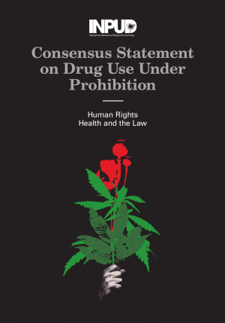
“Further to being seen as dangerous and criminal, people who use drugs – particularly those with drug dependencies – are understood to be sick and pathological. This results from what may be referred to as the ‘addiction-as-disease’ model, which constructs people who have drug dependencies as having a ‘disease’, as being sick, dangerous, and unable to exercise agency and self-determination." (p.9)*
“[It] is counterproductive to address drug use as a public health problem, or health problem at all. I mean, it’s counterproductive. I understand that to a certain degree this is partly needed, but the most of this discourse is bad because it’s patronizing people … this must be changed, because we are not ill because we use drugs.” (Društvo AREAL, Slovenia, London consultation) (p.10)*
* Consensus Statement on Drug Use Under Prohibition

Slide 18
Human Rights of People who Use Drugs?
RIGHT 1: People who use drugs are entitled to their human rights, which must be protected by the rule of law
RIGHT 2: People who use drugs have the right to non-discrimination
RIGHT 3: People who use drugs have the right to life and security of person
RIGHT 4: People who use drugs have the right not to be subjected to torture or to cruel, inhuman, or degrading treatment
RIGHT 5: People who use drugs have the right to the highest attainable standard of health
RIGHT 6: People who use drugs have the right to work, to free choice of employment, to just and favorable conditions of work, and to protection against unemployment
RIGHT 7: People who use drugs have the right not to be subjected to arbitrary arrest or detention
RIGHT 8: People who use drugs have the right to bodily integrity
RIGHT 9: People who use drugs have the right to found a family entitled to protection by the law, entitled to privacy, and entitled to be free from arbitrary interference
RIGHT 10: People who use drugs have the right to assemble, associate, and form organizations
* Consensus Statement on Drug Use Under Prohibition
Notes:
Font enlarged to 32
But are these rights well founded?

Slide 19
Are INPUD’s Essential Demands Reasonable?
Is it reasonable that “people who use drugs must not be assumed to be sick. ”?
Is it reasonable that “drug-userphobia and drug-shaming must be legally recognized as discrimination and hate speech”?
Is it reasonable that “drug use should be a protected human right like race or sex "?
Is it reasonable that there be “No discrimination anywhere… including negative attitudes, where you use, right to advocate for it, and any negative comments to or about drug use will be hate speech“?
* Consensus Statement on Drug Use Under Prohibition

Slide 20
UNAIDS 2015 Reference A Public Health and Rights Approach to Drugs
56-90% of people who inject drugs are incarcerated at some point
Strong support for opioid supportive therapy
Asks that drug using groups help design programs
Only voluntary drug testing and no discrimination in workplace settings
A Public Health and Rights Approach to Drugs UNAIDS 2015

Slide 21
The Universal Declaration of the Human Right to Direct Spiritual Experience*
Religious membership and activity is universally recognized as a "fundamental human right and protected by law, but individual pursuit of spiritual experience is not."
"All practices that contribute to an individual cultivation of direct spiritual experience are hereby affirmed to be protected by international laws and recognizing universal human rights."
“International drug laws are not sufficient group for baring the legitimate use of ethnogenic sacraments for personal spiritual experience.”
* Presented at the United Nations UNGASS 2016 by: Rt. Rev. Dr. Yashpal Jayne, PscD, Bishop written by: Martin W. Ball, Ph.D

Slide 22
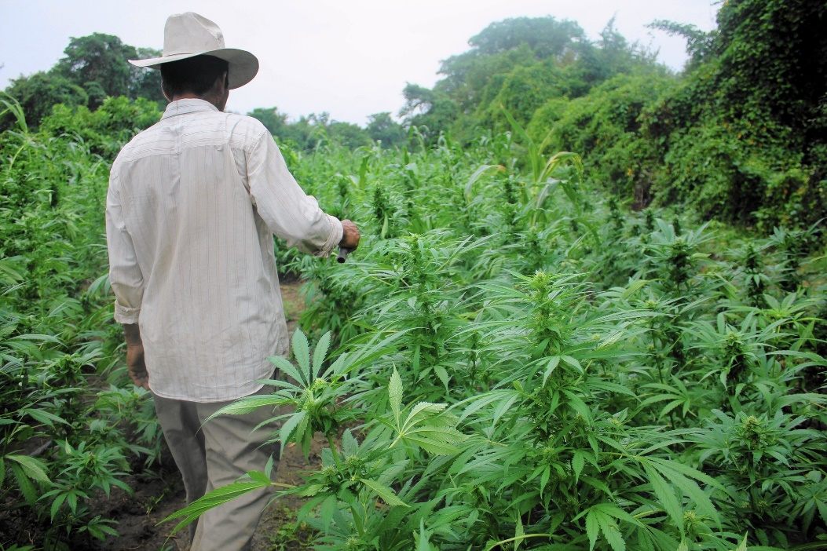
Those That Cultivate and Grow Drug Producing Crops
The right to grow marijuana, cocaine and opioids
Assistance developing alternative crops
Possibility: How much did the farmers receive versus all the middle men? Could money laundry profits from those who sold be obtained and used to help the villages after the crops are destroyed?

Slide 23
Human Rights
Just and fair laws, equal justice, rehabilitative justice: applies to drugs but also other issues
Right to live in a drug free community
Right to treatment and recovery

Slide 24
THE CONVENTION ON THE RIGHTS OF THE CHILD: Article 33: Children and Drug Use
Article 33 (Drug abuse): Governments should use all means possible to protect children from the use of harmful drugs and from being used in the drug trade.
Implementation Handbook for The Convention on the Rights of the Child Article 33 requires that: “States Parties shall take all appropriate measures, including legislative, administrative, social and educational measures, to protect children from the illicit use of narcotic drugs and psychotropic substances as defined in the relevant international treaties, and to prevent the use of children in the illicit production and trafficking of such substances.”*
* Implementation Handbook for the Convention on the Rights of the Child
Notes:
emphasis on prevention and drug free families and a communities
??Rights of the child who is experimenting with or using drugs
Selling drugs under the direction of an adult
Right to treatment.

Slide 25
Does Addiction Take Away Your Rights as a Person?
Those in recovery say YES!
They were driven to use drugs. Drugs controlled their whole lives and stole their personhood
Treatment gave me my life back
Drug addiction was a worse prison than jail

Slide 26
“Addiction is a disease with
significant negative consequences…"
Short Definition of Addiction:
Addiction is a primary, chronic disease of brain reward, motivation, memory and related circuitry. Dysfunction in these circuits leads to characteristic biological, psychological, social and spiritual manifestations. This is reflected in an individual pathologically pursuing reward and/or relief by substance use and other behaviors.
ASAM’s Public Policy Statement: Definition of Addiction

Slide 27
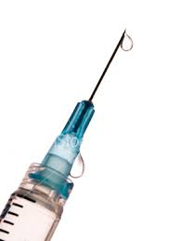
Drug Use and Human Rights
A right to treatment
A right to work in a drug free environment
A right to recovery

Slide 28
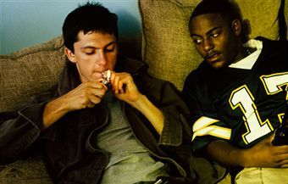
Viewing Drug Abuse And Addiction As A Contagious Disease
Usually introduced to drug use by friends, dealers and family members.
The best protection is to grow up in a drug free community or community with very negative attitudes toward drug use, not a community where drug use is accepted and a protected right

Slide 29
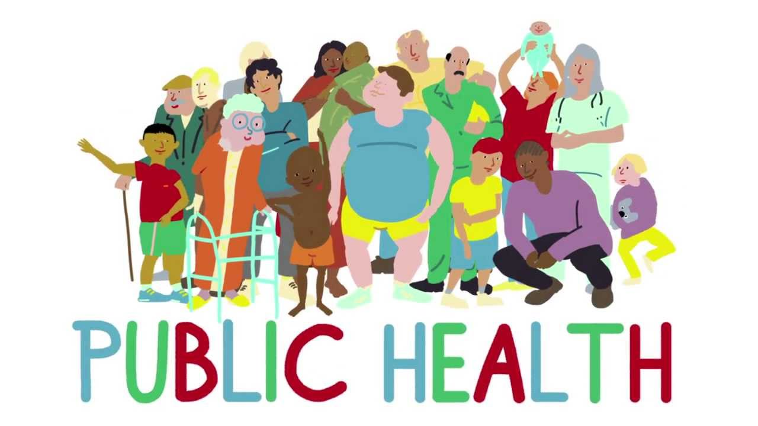
Public Health Approaches in Addition to Harm Reduction
Harm reduction is a public health measure to reduce damage but not to address the underlying problem
Prevention of first use. Prevention of people introducing others to drugs (spreading)
Treatment in an early stage (easier in a community where drug use is not normalized)

Slide 30
Stronger Public Health Measures
Quarantine: Infectious disease
Prevention of movement: Ebola
Contaminated food
Poisoning the water supply
?? fentanyl in the US

Slide 31
Public Health Approaches
Tobacco: success: In US, much less use. It is legal but with limited advertising and negative beliefs about it from most of society
Smokers do not celebrate their smoking or demand rights
Marijuana in the US. Its medical, religious, a human right and people celebrate laws that legalize it.
Does legalization mean celebration?

Slide 32
Whose Rights, What Rights?
Right to treatment and recovery
Prevention for youth, including addressing underlying causes such as homelessness
Treatment rather than prison
Full public health approaches
Improving laws, Justice in the application of all laws

Slide 33
and
2016 ASAM issues a short statement at UNGASS: Addiction is a medical problem and requires treatment. Encourages nations to develop better treatment systems and to contact ISAM for names of ISAM members in their nation that might help. There is need for much more education of physicians and many others in treatment of addictions.
Can we produce a more robust ISAM membership that could provide this?

Slide 34
www.ISSUP.net
Nongovernmental agency to support the development of a professional prevention and treatment workforce
Receives government and nongovernmental funding. Budget and staff are much larger than ISAM
Developed international standards for the treatment of drug use disorders and standards for prevention
Has learning centers and courses throughout the world

Slide 35
Education Providers
In Asia 15 sites plus 25 national focal points
US: University of South Florida and Iowa State
In Africa 15 sites
None in Europe

Slide 36
How Should ISAM be Involved?
Help society to realize that addiction is a preventable and treatable disease. Treatment should be a human right.
ISAM provides updates and tries to have representation at future UN meetings
Talk with our UN representatives
Support educational efforts internationally
Normwetterau@aol.com

Slide 37
References on UN Drug Policy and on Human Rights
UNODC United Office of Drugs and Crime The International Drug Control Conventions
Single Convention on Narcotic Drugs of 1961 as amended by the 1972 Protocol Convention on Psychotropic Substances of 1971 United Nations Convention against Illicit Traffic in Narcotic Drugs and Psychotropic Substances of 1988 with final acts and resolutions United Nations, NY 2013
UNODC: Outcome Document of the 2016 United Nations General Assembly Special Session th the World Drug Problem Thirtieth Special Session General Assembly New York April 2016
United Nations Human Rights: Convention on the Rights of the Child. November 20, 1989
Children and Drug Abuse: Implementation Handbook for the Convention on the Rights of the Child part 3 Article 33 UNICEF 2007

Slide 38
References on the Spectrum of Human Rights and Drug Use.
Report Civil Society Task Force for UNGASS, December 2014, to April 2016 Vienna NGO Committee on Drugs and NYNGOC New York NGO Committee on Drugs
Barrett, Damon and Nowak, Manfred, The United Nations and Drug Policy: Towards a Human Rights-Based Approach (August 25, 2009). THE DIVERSITY OF INTERNATIONAL LAW: ESSAYS IN HONOUR OF PROFESSOR KALLIOPI K. KOUFA, pp. 449-477, Aristotle Constantinides and Nikos Zaikos, eds., Brill/Martinus Nijhoff, 2009. Available at SSRN: https://ssrn.com/abstract=1461445

